Slide 1

DEPARTMENT OF COMPUTER SCIENCE & ENGINEERING
DATA ANALYTICS (23CST-613)
M.E. – 1st SEMESTER
COURSE COORDINATOR: DR. MANJIT SINGH

Slide 2
Descriptive vs. Inferential
Descriptive: e.g., Mean; describes data you have but can't be generalized beyond that
We’ll talk about Exploratory Data Analysis
Inferential: e.g., t-test, that enable inferences about the population beyond our data
These are the techniques we’ll leverage for Machine Learning and Prediction

Slide 3

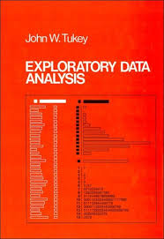
Exploratory Data Analysis 1977
Based on insights developed at Bell Labs in the 60’s
Techniques for visualizing and summarizing data
What can the data tell us? (in contrast to “confirmatory” data analysis)
Introduced many basic techniques:
5-number summary, box plots, stem and leaf diagrams,…
5 Number summary:
extremes (min and max)
median & quartiles
More robust to skewed & longtailed distributions

Slide 4
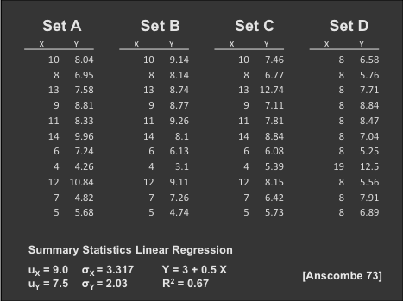
The Trouble with Summary Stats

Slide 5
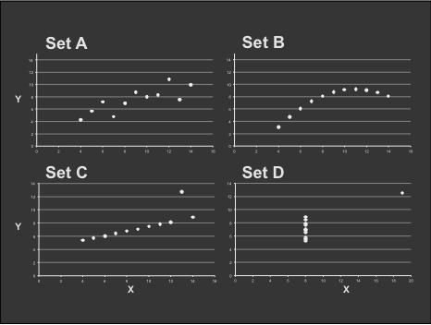
Looking at Data

Slide 6
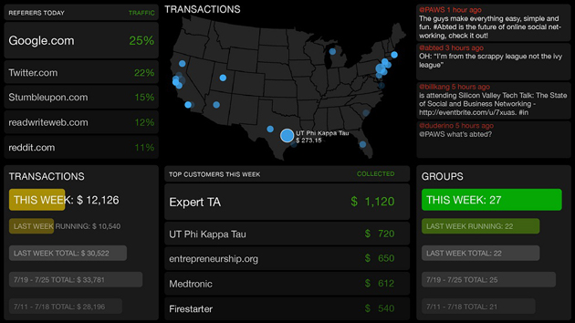
Data Presentation
Dashboard
6

Slide 7

Data Presentation
Data Art
7

